Slide 1
The Great Depression
1929-1941

Slide 2
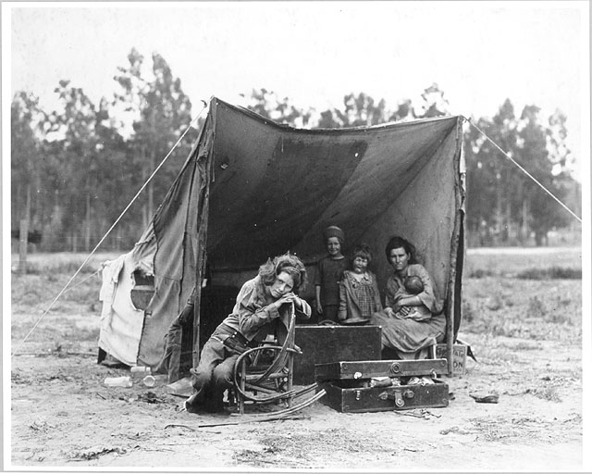

Slide 3
In 1928, presidential candidate Herbert Hoover promised to grow the economy

Slide 4
After Hoover won the election, the stock market became a bull market
There was speculation in stocks
People bought stocks on margin

Slide 5
There was a call on the stocks
Some investors did not have money to pay for the stock they had bought
Professional investors sold their stock

Slide 6
The stock market crashed on October 21, 1929
It was called Black Tuesday

Slide 7
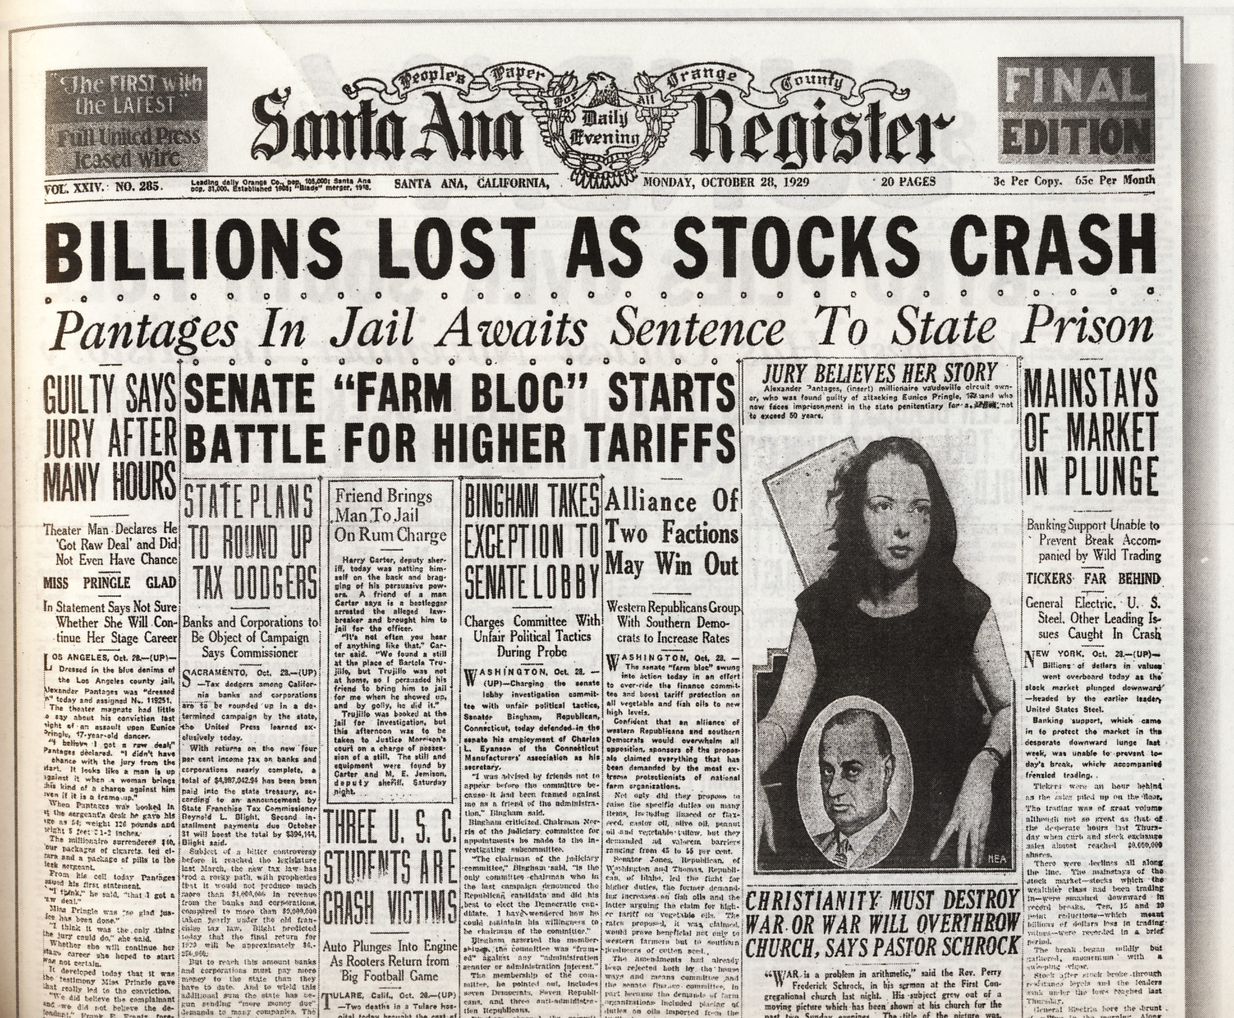

Slide 8
Billions of dollars were lost
The stock tickers ran for hours trying to handle the extraordinary amount of trading

Slide 9
Bankers were adversely affected
They lost money from stock speculators

Slide 10
Bankers lost their depositor’s money in the risky stock market

Slide 11
The stock market crash was a domino effect
It hurt the banks, then businesses, then consumers

Slide 12
The lack of money in circulation also caused a recession

Slide 13
Today we have the FDIC to protect against the first $250,000 of our money against a bank failure

Slide 14
Depositors saw friends lose money in the banks
This caused bank runs

Slide 15

The movie It’s a Wonderful Life by Frank Capra shows a bank run

Slide 16
In comparison, in the early 1800’s there were many local or state banks
The Bank Panic of 1857 had little to no effect

Slide 17
There was inconsistency in the practice of defining a bank and its branches in the 1800’s

Slide 18
Moving forward to the 1920’s, 70 banks failed each year nationally
After the crash 10 times as many banks failed

Slide 19
There was a loss of export sales
This resulted in less jobs for Americans

Slide 20
The Hawley-Smoot Tariff passed in June 1930
It protected American industry by taxing foreign competitors

Slide 21
Both 2016 presidential candidates agreed that outsourcing is a major problem affecting the U.S. economy

Slide 22
The Dust Bowl occurred during the same time as the Great Depression
Drought in the Great Plains

Slide 23
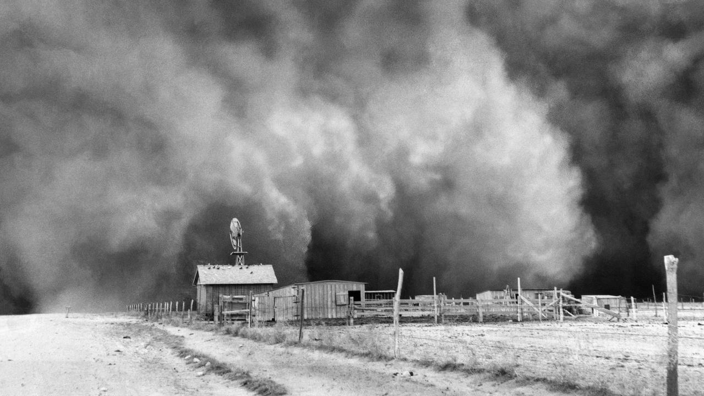

Slide 24
Dust storms destroyed crops & livestock
The dry, subsoil became unfit for planting
The dust storms caused animals and people outside to suffocate

Slide 25
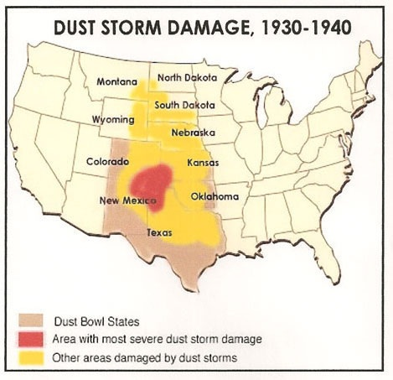

Slide 26
Farmers and other unemployed workers traveled elsewhere to find a job
They would hop on the trains
They became known as hobos

Slide 27
The traveling unemployed workers put up shacks
These communities were known as Shantytowns

Slide 28
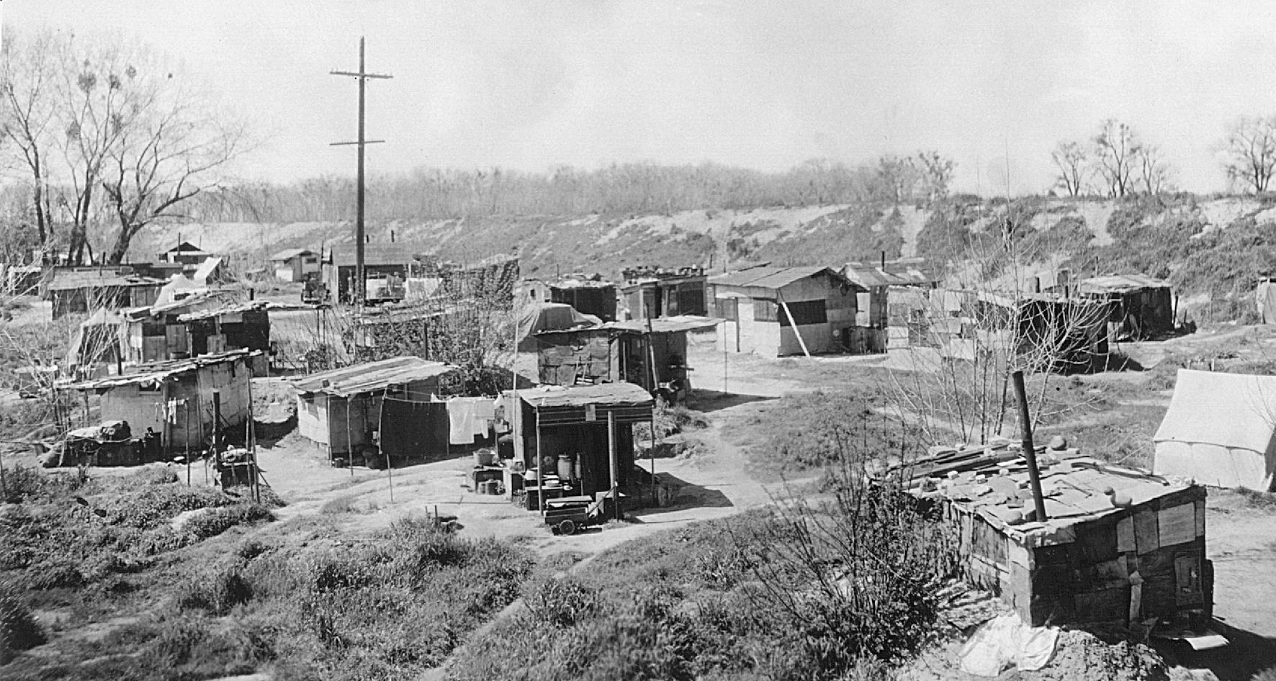

Slide 29
Hungry people flocked to soup kitchens or breadlines to get food

Slide 30
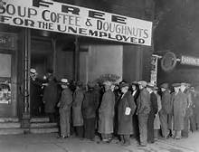

Slide 31
Today the modern soup kitchen is called the food stamp program or SNAP

Slide 32
Entertainment was a way to cope with daily struggles
Comic books and radio helped people forget their problems for a moment

Slide 33
The hero’s Superman and Batman came out of this era
Movies were another way to escape reality

Slide 34
People flocked to see The Grapes of Wrath & My Man Godfrey
Movies stars such as Clark Gable, Bette Davis, Greta Garbo and Shirley Temple became popular

Slide 35
A popular song for this time was Brother Can You Spare a Dime?

Slide 36
President Hoover believed rugged individualism & volunteerism would solve the Great Depression
Hoover initially supported the laisse-faire philosophy

Slide 37
Hoover signed the Emergency Relief and Construction Act of 1932
Hoover increased spending in public works which created a few jobs

Slide 38
This relief was too late for workers such as Mr. Garrett that went on WPA (Works Public Administration)
Garrett later ran out of work again

Slide 39
Mrs. Garrett asked the Red Cross for help
The Red Cross ran out of supplies

Slide 40
People took to the streets in hunger marches
The Unemployed Citizen magazine sprang up

Slide 41
It was an especially hard times for miners, timber workers and farmers
Creditors evicted farmers from their homes
Bill collectors were chased away

Slide 42
Veterans groups such as the Bonus Army asked for help
They were given bonds promising $1,000 in the future

Slide 43
The Bonus Army marched for their money early
They erected a large Hooverville by the capital

Slide 44
The U.S. government ran the veterans out of town
Hoover’s reputation became stained with this incident

Slide 45
The country was ready for the Democratic contender Franklin Delano Roosevelt

Slide 46
Roosevelt vowed to end the Great Depression with what was called New Deal policies

Slide 47
Roosevelt enacted the Hundred Days Policy
Congress passed 15 major acts to resolve the economic crisis

Slide 48
Roosevelt called for a national bank holiday
Roosevelt said, “The only thing we have to fear, is fear itself”

Slide 49
Some of the legislation included the Agriculture Adjustment Act, Resettlement Administration, Civilian Conservation Corps and National Industrial Recovery Act

Slide 50
Additional legislation included the Tennessee Valley Authority, FDIC and the Social Security Act of 1935
The TVA, FDIC and SSA continue today

Slide 51
America’s involvement in WWII helped to create jobs
Workers were needed in the bomber and artillery plants such as Willow Run and Kelsey-Hayes in Michigan

Slide 52
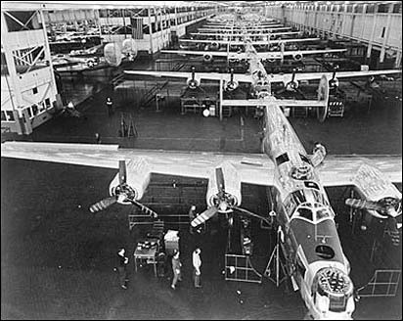

Slide 53
The Great Depression was a challenging time for Americans, businesses and the government
This was a time when Americans came together to solve the challenges of the day

